Slide 1

Server Remove/Replace
September 23, 2011

Slide 2
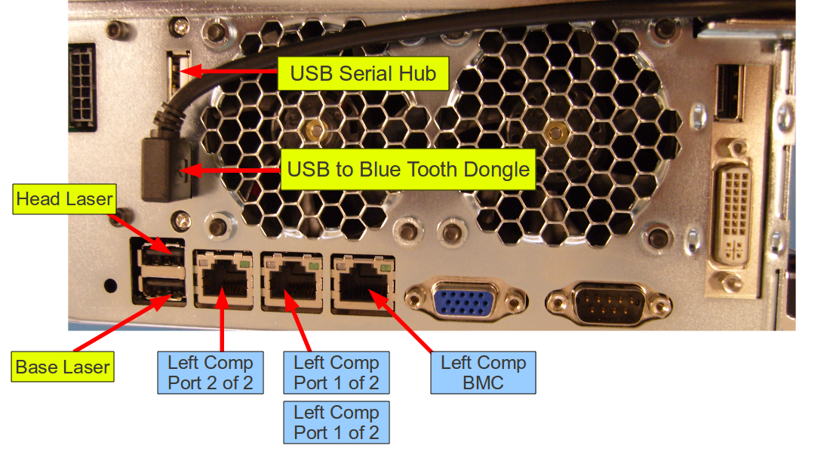
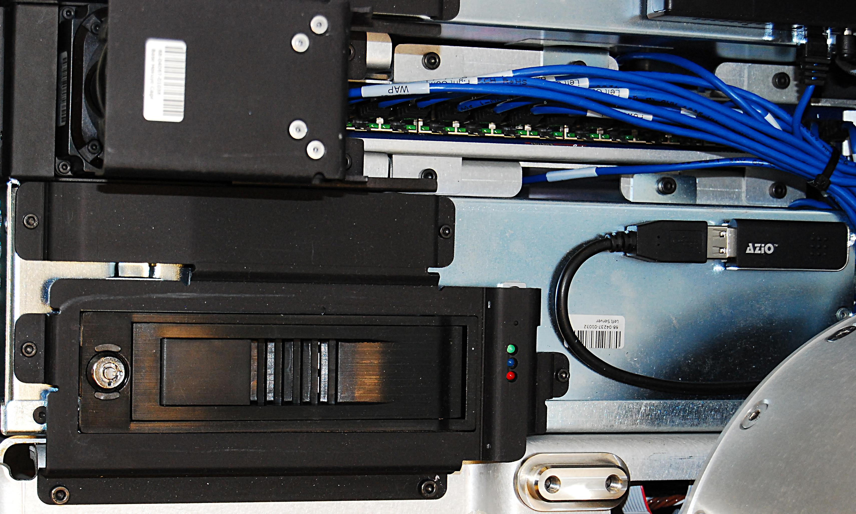
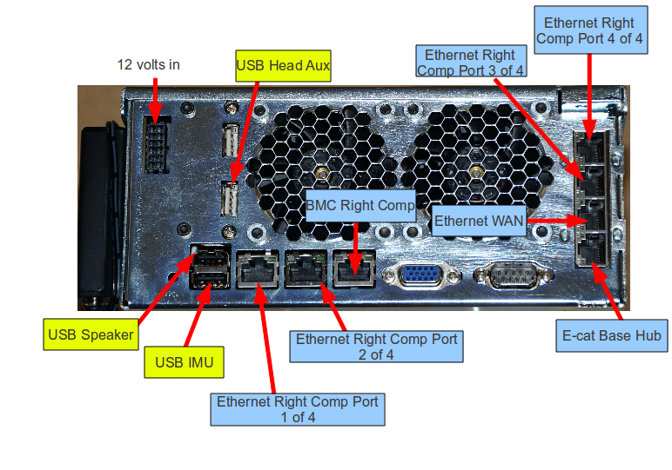
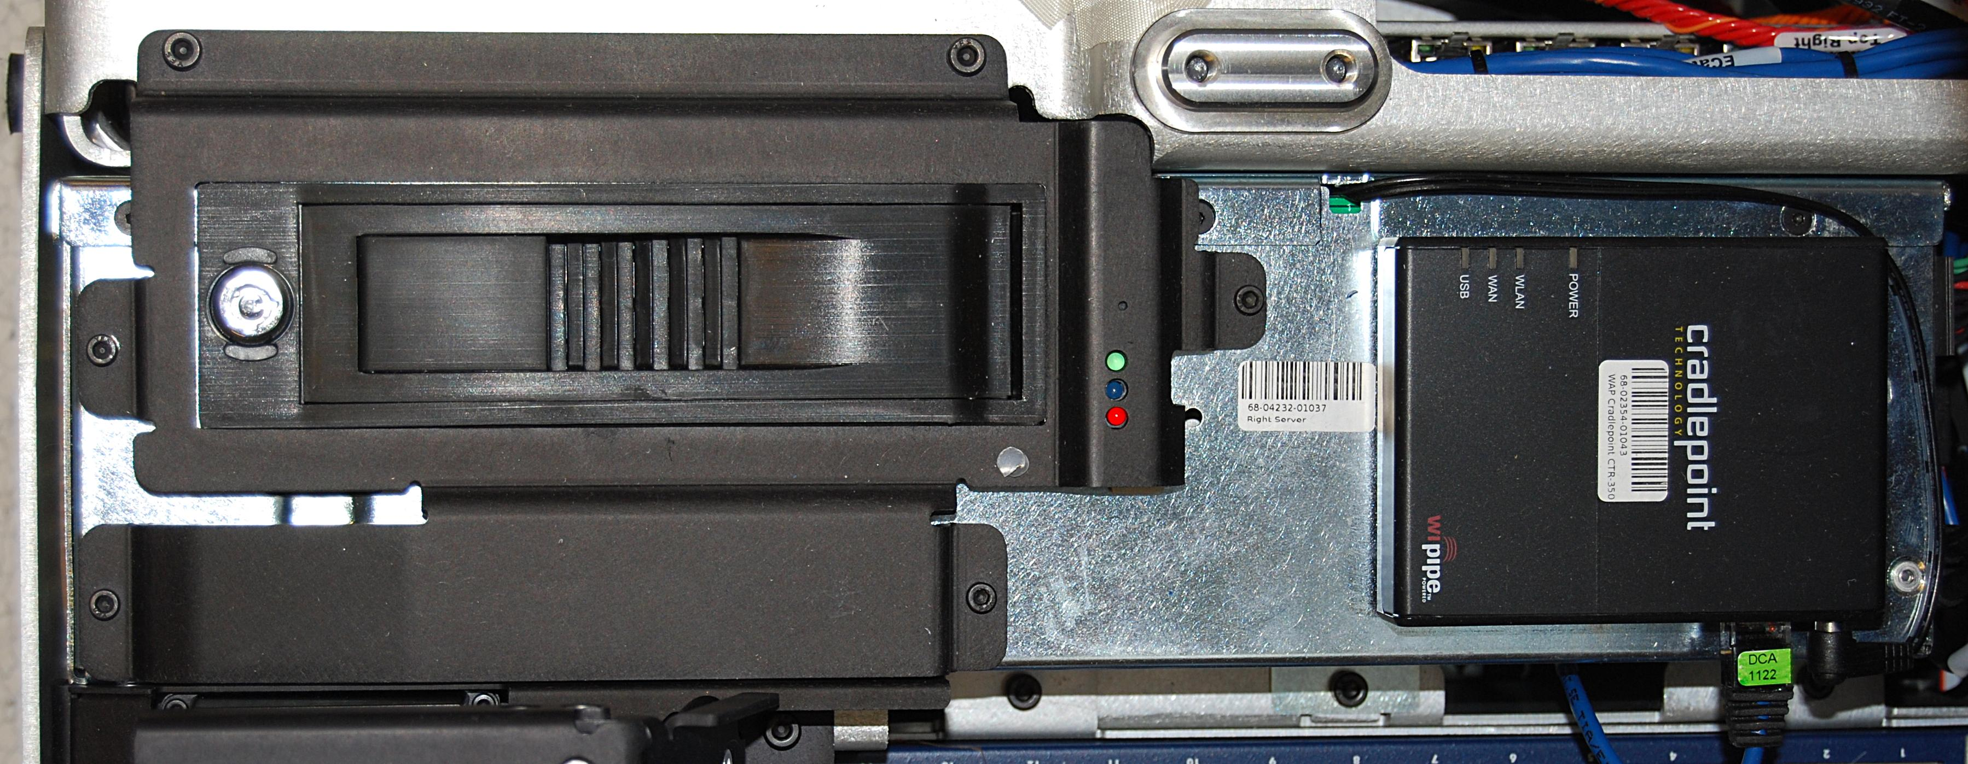
Server Remove/Replace
Refer to the PR2 Overview document for additional information.
Reconnect all cables to the server. Look at the labels on the cables and (Fig. 3 for left server, Fig. 4 for right server) below
Move the spine of the robot all the way up, turn the robot off, and remove the front bottom panel and front bellows
Refer to Doc2 for instructions on how to remove the front bottom panel
Refer to Doc9 for instructions on how to remove the front bellows
Remove the 3 screws that secure the server to the base using a 3mm bit with the T-handle driver (Fig. 1 for the left server, Fig. 2 for the right server)
Fig. 3 Left Server
Fig. 1 Left Server
Fig. 4 Right Server
Fig. 2 Right Server
Reinstall the server into the base of the robot using loctite 248 and a torque of 3.17 N-M
Reinstall the front bellow (refer back to Doc9) and reinstall the bottom panel onto the robot (refer back to Doc2)
Slowly and carefully lift the server up out of the base and disconnect all cables from the back of the server
Install the replacement server

